Slide 1
The Problem of Evil

Slide 2
The story of Jackie Corbin
Jackie Corbin was an 8 year old girl who was kidnapped off the street in front of her home in 1980 while her parents were cooking Christmas dinner.
2 days later, her murdered body was found north of Los Angeles County. It was one of the most disturbing crime scenes that Jim Wallace ever heard about.
A 22 year old man named Francis Denny was arrested.
Denny was acquainted with Jackie’s family, he was in the area when Jackie went missing, and he seemed unconcerned as officers told him about the gruesome details of Jackie’s murder.
But Denny was eliminated as a suspect because of some exculpatory blood evidence. There was no way to reconcile the blood evidence with Denny as a suspect.
The real murderer was never found, and the case is still open.

Slide 3
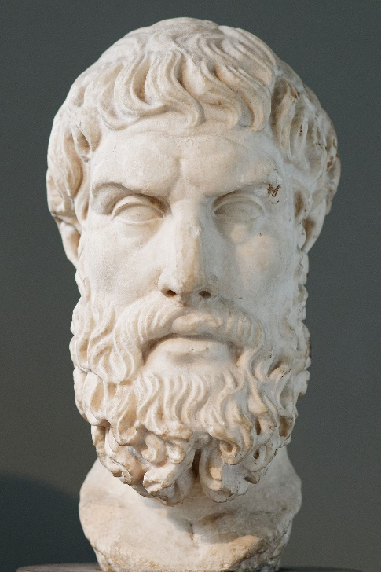
Epicurus’ problem of evil (341-270 BC):
"Is God willing to prevent evil, but not able? Then he is not omnipotent.
Is he able, but not willing? Then he is malevolent.
Is he both able and willing? Then whence cometh evil?
Is he neither able nor willing? Then why call him God?”
Evil is often presented as exculpatory evidence against God’s existence.
The underlying assumption is that there can be no good reasons for God to allow evil. But is this true?
Are there any reasons as to why an All-powerful and All-good Being might allow evil?
Jim gives us 7 points to consider when trying to reconcile the existence of evil with the existence of God…

Slide 4
Point 1 – An accurate view of eternity
As an atheist, Jim wanted to have a 90 year, pain-free life. If he got cancer at the 40 year mark, suffered for 10 years, and died at 50, he would have called that “evil”.
But on the Christian worldview, we don’t stop existing after death. There is an eternal aspect to our existence. Any pain that might happen in our time on Earth must be considered in that eternal context.
Think of a painful experience you had as a child. At the time, the pain seemed terrible. But now, the pain is just a distant memory. You might hardly remember it now.
Our experience and understanding of pain and evil must be contextualized within eternity, not within our temporality.

Slide 5
Point 2 – Proper reverence for free agency
Free will is a vital for love. There can be no real love unless it is freely given. “Coerced love” is an oxymoron. If the Creator of the universe considers love to be the highest moral virtue, the only option available is to create a universe in which humans have the freedom to choose love.
But in order to have the freedom to love, we must also have the freedom to hate.
With the reality of free will comes the possibility of evil. People can use their free will to choose to do wrong. Some of the evil that people suffer from is a result of their or other people’s free choices.
Freedom, in all its beauty, does not come without associated dangers.

Slide 6
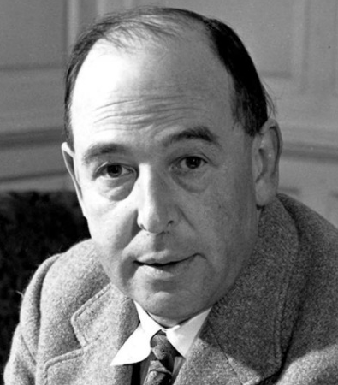
Point 3 – Appropriate definition of love
We often think that pain has no place in love. We think of love in terms of kindness, gentleness, affection, etc. But love is far more complicated than that.
Sometimes the deepest, truest expression of love comes in a form of discipline. God may allow evil to exist to be used in punishment or discipline. If we do not allow love to sometimes feature correction, then we are reducing love to a simple, unrealistic caricature.
“We want, in fact, not so much a Father in heaven as a grandfather in heaven – a senile benevolence who, as they say, ‘liked to see young people enjoying themselves,’ and whose plan for the universe was simply that it might be said at the end of each day, ‘a good time was had by all.’” – C. S. Lewis
If God’s loving nature is as broad and all-encompassing as that of a parent, we should expect some difficult circumstances to be an evidence of His love, especially if a greater good is achieved from the temporary suffering.

Slide 7
Point 4 – Role in character development
A loving parent will be concerned for their child’s character more than their comfort. Character is developed through adversity more than advantage. God may allow His children to go through hard times to forge our character with eternity in mind.
Wisdom is typically the product of failure, not success.
Hardships are opportunities to show selflessness. In fact, without hardship, good character is hard to come by.
Jim has seen many families who have suffered loss develop endurance and perseverance, and grow in patience and empathy.
After natural disasters, an influx of people volunteer to help relief organisations.
In the face of hardships, true courage, compassion, forgiveness, self-sacrifice, and charity are developed.
“To ask that God’s love should be content with us as we are is to ask that God should cease to be God: because He is what He is, His love must, in the nature of things, be impeded and repelled by certain stains in our present character, and because He already loves us He must labor to make us lovable.” – C. S. Lewis

Slide 8
Point 5 – Power to draw us to God
Tragedy has a way of redirecting our thoughts toward God and eternity. Even atheists have secretly whispered prayers of desperation.
When we reach the end of our rope, we often start looking for help beyond ourselves. Pain and suffering can refocus our attention, remind us of the nature of eternal life, and draw us to our Creator.
“Pain insists upon being attended to. God whispers to us in our pleasures, speaks in our consciences, but shouts in our pains. It is His megaphone to rouse a deaf world.” – C. S. Lewis

Slide 9
Point 6 – Consequences of our sin
Sometimes, our suffering is just the result of our own bad choices, even choices from years ago.
Even as an atheist, Jim embraced the concept of “reaping and sowing”.
Ideas and actions have consequences, and sometimes those consequences are painful.

Slide 10
Point 7 – Our limited understanding
Even though we try to think of possible explanations of why God may allow evil, we need to accept that God knows a lot more than we do. Even if we can’t see or even think of a reason for some of the suffering we see, that does not mean that an omniscient Being can’t see the reason.
If there is a vastly superior Divine Creator, we shouldn’t expect to understand every motive, thought, or set of concerns in the Creator’s mind.
In fact, we should expect some evils to be inexplicable and mysterious to us because we lack the knowledge of future good that can come of it.

Slide 11
Connecting the points
We’ve looked at 7 points to consider when trying to reconcile the existence of evil with the existence of God.
1. Accurate view of eternity.
2. Proper reverence for free agency.
3. Appropriate definition of love.
4. Role in character development.
5. Power to draw us to God.
6. Consequences of our sin.
7. Our limited understanding.
No single explanation will account for all suffering or every evil act. Every act that we investigate must engage all of these 7 points.
But these 7 points will factor into a situation with different proportions and connections to one another. A specific answer for pain and suffering can be a complex web of explanations.

Slide 12
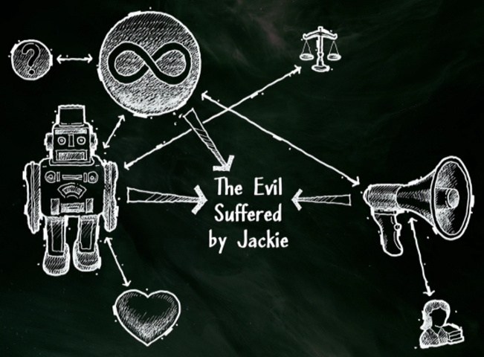
Connecting the points
Take Jackie’s case as an example. Human free agency was a significant factor as the murderer made a choice to murder Jackie. Whatever suffering Jackie experienced in her last moments must be considered in the light of eternity. This tragedy also had the potential to contribute to the character and focus to those affected by it.
"It's so complicated. All of this only begins to explain this act... Every case I've ever worked is this complex. This is just the nature of working homicide. Something happens in a heartbeat, takes me 30 years to put it back together. And when I do, she's still dead. This is the nature of evil. This is why we have to evaluate evil differently." - Jim Wallace

Slide 13
Reassessing Epicurus’ problem of evil
"Is God willing to prevent evil, but not able? Then he is not omnipotent.
Is he able, but not willing? Then he is malevolent.
Is he both able and willing? Then whence cometh evil?
Is he neither able nor willing? Then why call him God?”
Is there any good reasons for an All-powerful, All-loving God to allow evil things to happen?
We can’t know God’s exact reasons for allowing every particular instance of evil to occur. But we’ve seen 7 things that can factor together to offer some potential explanations.
Also, the classical definition of God goes beyond All-powerful and All-loving. As a Maximally Great Being, is He not also All-wise and All-knowing? Surely that adds more perspective to the problem? Epicurus’ problem of evil is too simplistic. Reality is complex and the answer to why evil things happen is also complex.
And as we saw in our previous session, without God’s nature providing an objective foundation upon which morality is based, we would have no way of saying anything is good or evil. People who use the problem of evil to justify their atheism need God in order to make their argument against God.

Slide 14
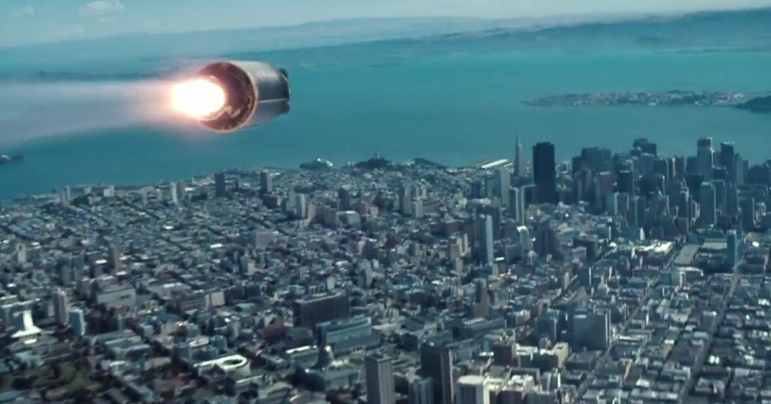
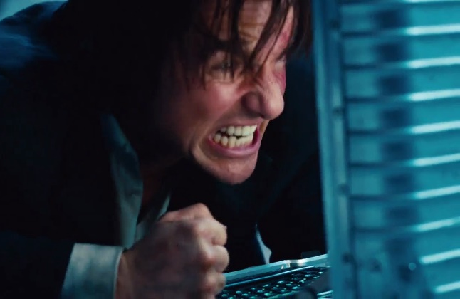
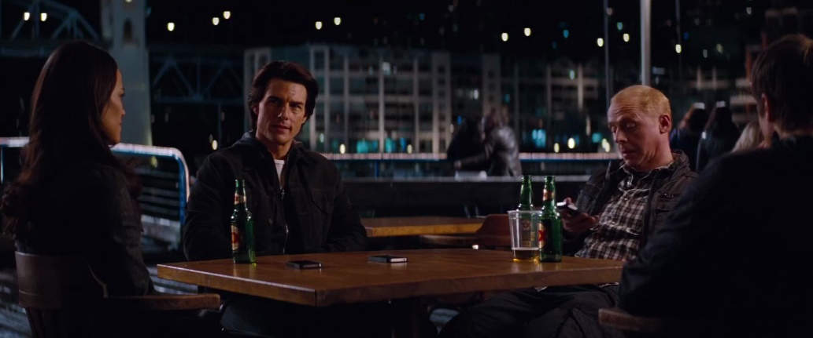
A couple more thoughts…
In the movie Mission Impossible IV, the Mission Impossible team are trying to stop a nuclear missile from hitting a city.
They successfully disarm the missile just in time, then they meet at a café to debrief.
One of the team members says, “All these people are just happy and smiling, and they are completely oblivious to the fact that they were almost vapourised.”
We may see bad things happen and complain that God did not stop it. But how would we know if He did? Perhaps God has saved us from countless terrible fates and we have no idea how close we came to obliteration.

Slide 15
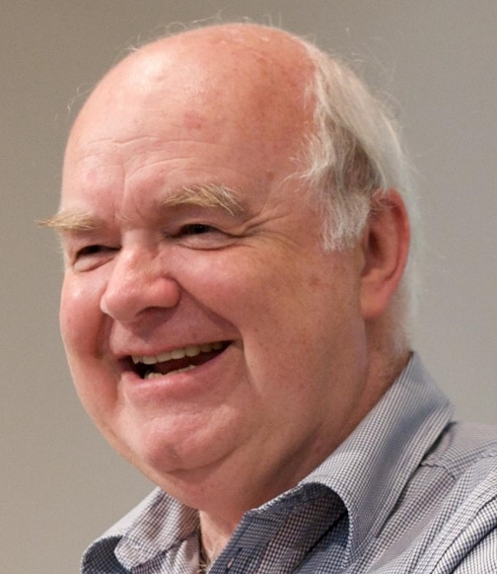
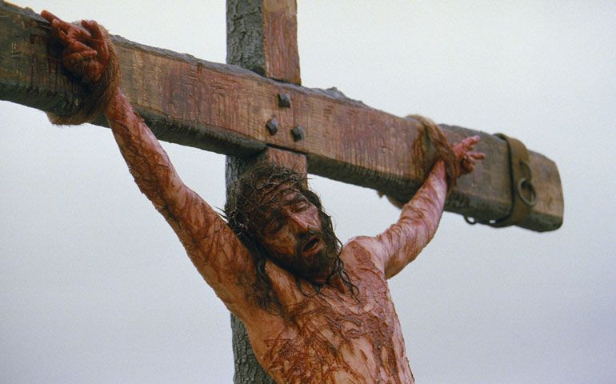
A couple more thoughts…
John Lennox gives a talk about where God is in pain and suffering.
“We say, ‘Could/would/should a good God have done this?’. We can argue day after day, and none of us have come to a satisfactory conclusion. Perhaps we ought to ask a different question. Granted that it is like that [that suffering happens], is there any evidence anywhere in the universe that God can be trusted with a real answer to it?“
"At the heart of Christianity is something utterly unique. It's a cross. Nietzsche used to mockingly say, ‘This “God” on the cross!’ The claim is that Jesus is both God and human - the question that Nietzsche mocked is very real. What is God doing on a cross? At the very least, it shows me that God has not remained distant from the problem of human suffering and evil, but has Himself become part of it.“
"I could begin to trust a God like that. Jesus was raised by the power of God. That changes the whole world for me. If it is true first of all that God has participated in suffering, and secondly that Jesus has broken the death barrier, then maybe there is some truth to His claim that He is going to operate the final judgment."

Slide 16
Objections
We need to handle the problem of evil very carefully. With other objections to God’s existence, we can use reason and appeal to evidence as we try to rationally deal with the objection.
But people who question how God can allow evil often do so because of pain and suffering in their own lives, and the emotions and hurt surrounding those events can still be very raw.
The best thing we can do for someone who is hurting is to be there for them. Mourn with them. Don’t offer intellectual responses to them in their grief. It won’t help. Instead, show them the love of Jesus, as we are commanded to do. Eventually, there may be an opportunity to discuss with them about how God can permit bad things to happen, but don’t rush it. The goal is to love the other person.

Slide 17
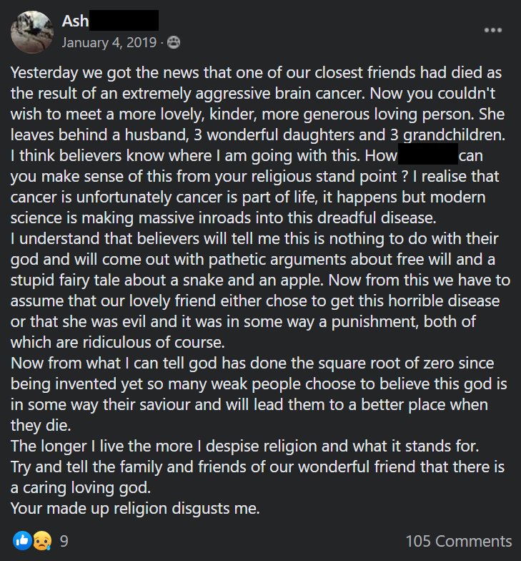
Objections
This is a post on an atheistic Facebook group from a committed atheist called Ash.
Imagine this happened in person to a friend of yours. How should you respond?
Ash has simplified theistic responses down to just free will and punishment for sin. But we’ve seen that the actual theistic response to evil is far more complex and nuanced than that.
But Ash was obviously upset at the death of his friend and angry at theists that would try reconcile that tragedy with a loving God.
He was not in any emotional state to rationally consider theistic responses. He just needed people to care for him and be with him as he mourned. Perhaps in time God will bring him to a place where he is ready to talk about God.

Slide 18
Objections
Some people may say, “Ok, so it’s logically possible that God exists while allowing evil things to happen. But it is very improbable that a loving God would permit so much evil and suffering. At the very least, the excessive amount of suffering in the world makes God’s existence very unlikely.”
Philosopher William Lane Craig offers 3 points in response to this (some of which we’ve already looked at):
We are not in a position to say that God probably lacks reasons for allowing suffering. We are limited in time and space, and in intelligence and insight. In order to achieve His purposes, God may have to allow a great deal of suffering along the way.
Relative to the full scope of the evidence, God's existence may well be probable. Probabilities are always relative to background information. If we consider only the suffering in the world, then God's existence may appear to be improbable. But if we look at all the powerful arguments for God's existence, then we may come to a different conclusion.

Slide 19
Objections
Christianity entails doctrines that increase the probability of the co-existence of God and suffering. Consider these 4 doctrines:
The chief purpose in life is not happiness. People often think that God is obligated to keep us happy. However, Christianity holds that the purpose of life is to know God, which alone provides true, lasting fulfilment. Suffering can be used as a tool for God to draw people closer to Him.
Mankind is in a state of rebellion against God and His purpose. Terrible human evils show man's depravity, a consequence of his alienation from God. Christians are not surprised by the evil in the world; they expect it.
God's purpose is not restricted to this life, but carries on into eternal life, beyond the grave. This life is just the beginning. Our life on earth is temporary. Our pain will not endure forever, and one day our sufferings will be overwhelmed by the joy of God.
The knowledge of God is an incomparable good. Knowing God is the ultimate fulfilment of human existence. Thus, the person who knows God, no matter how much suffering they endure, can say "God is good to me".

Slide 20
The case for theism:
Evidence inside the universe:
The origin of the universe
The fine-tuning of the universe
The origin of life
The design in biological life
Conscious minds
Free agency
A Moral Law
The existence of evil
Description of our “Suspect”:
External to the universe
Time-less, space-less, and immaterial
Uncaused
Extremely powerful
Specifically purposeful enough to produce a universe fine-tuned for life
Intelligent and communicative
Creative and resourceful
A conscious Mind
Free to choose and create personally
The personal source of moral truth and obligation
The standard for good by which we define evil

Slide 21
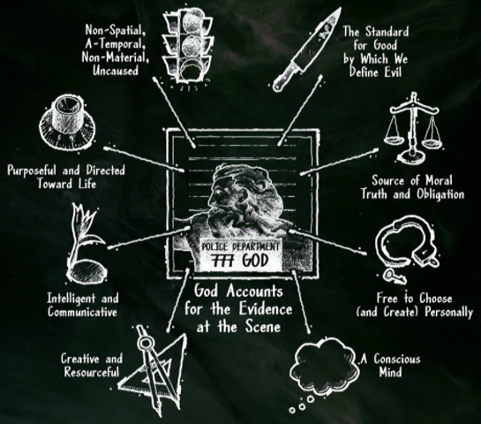
The case for theism:
We have built a cumulative case for the existence of God that looks remarkably like the God described in the Bible, just from evidence within the universe that is available to everyone. The Bible describes reality as it really is.

Slide 22
The case for atheism?
In order to make their case, atheists offer a plethora of attempts to explain the evidence that we have offered for the existence of God in some other way. But each of these alternative explanations are not supported by evidence, and atheists disagree with each other on which one is more reasonable.
Various atheists may posit an infinite multitude of universes to escape the idea of a Creator, despite the philosophical issues and lack of evidence for this.
They may have us believe that the information encoded in DNA came from either natural means (which has never, ever been shown to happen) or from an alien source.
They may try to convince us that our consciousness is an illusion, yet they trust their conscious thoughts telling them that.
They may try to show that morality is subjective, yet they all live as if there is a transcendent Moral Law.
Atheists do not adequately deal with the evidence that theists provide. They either propose outlandish alternative explanations, or they dismiss some evidence as just being illusions. Some of them even claim that there is zero evidence for the existence of God, even after a theist offers them some evidence.

Slide 23
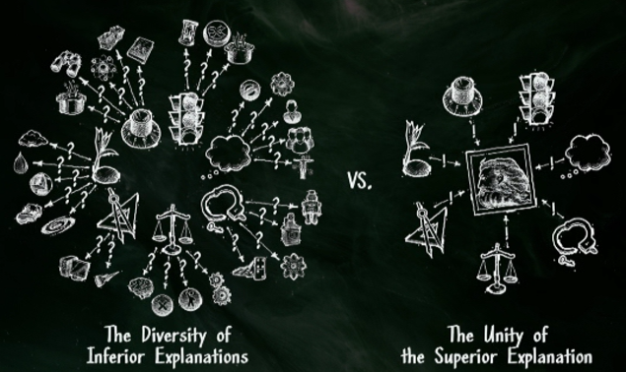
The case for atheism?
Rather than hold to a multitude of unevidenced, unreasonable, unrelated, coincidental alternative explanations, it is far more reasonable to believe the one, superior explanation that unifies all the evidence – the existence of God.

