Slide 1
Free Will

Slide 2
What is free will?
Being able to freely act or think without being determined by causal factors outside your own mind.
What is determinism?
All our choices are determined by previous physical events (like a chain of dominoes).
I.e. We could not have acted in any other way.

Slide 3
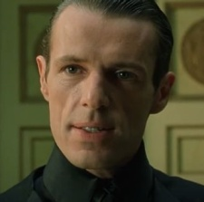
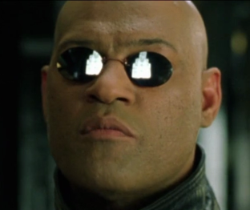
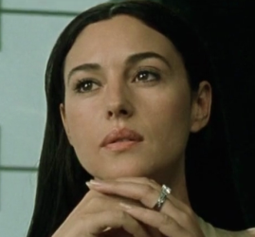
Determinism explained in The Matrix Reloaded by the Merovingian
“There is only one constant, one universal. It is the only real truth - causality. Action, reaction. Cause and effect.”
“Everything begins with choice.”
“No. Wrong. Choice is an illusion. And this is the nature of the universe. We struggle against it. We fight to deny it. But it is, of course, pretense. It is a lie. Beneath our poised appearance, the truth is, we are completely out of control. Causality. There is no escape from it. We are forever slaves to it.”
Just a few minutes later, the Merovingian’s wife, Persephone, betrays him.
“Persephone, how could you do this? You betray me.”
“Cause and effect, my love.”

Slide 4
Do we have free will?
Phil and Sandy were heroin addicts, and they were out of money and out of drugs.
Sandy drove them to a nice neighbourhood and waited in her car while Phil looked for an unoccupied house. He found one and then waited outside, smoking a cigarette and struggling with his decision.
Eventually he went ahead and burgled the house. Jim Wallace and his team were watching and arrested Phil.
Phil had a family history of heroin users and had been using drugs from a young age. His father and brother were both drug addicts, and his father was a convicted residential burglar.
Did Phil have a choice to commit the burglary? Given his upbringing, his history of drug addiction, and the fact that he hesitated before committing the crime and was still high at the time, did he really have the option to freely choose to commit the crime?
Or was Phil’s “decision” dictated by a series of physical events caused by uncontrollable chemical reactions in his brain?

Slide 5
Do we have free will?
A jury assessed Phil’s situation and concluded that Phil made several, free, uncoerced decisions as he entered a house to burgle it.
Phil’s upbringing and drug history were not considered to excuse Phil from the responsibility of his own choices.
If determinism is true and our physical past and the laws of nature are the only reasons behind our actions, our efforts to rightly praise or blame the actions of people is a nonsensical endeavour; our efforts at justice seem equally pointless.
In 1978, the Supreme Court (of US) said, “a deterministic view of human conduct” is “inconsistent with the underlying precepts of our criminal justice system.” The Court said that “belief in freedom of the human will and a consequent ability and duty of the normal individual to choose between good and evil” is the “’universal and persistent’ foundation stone in our system of law, and particularly in our approach to punishment, sentencing, and incarceration.”

Slide 6
Do we have free will?
Having free will means:
- We have responsibility for our actions.
We can be creative. Freedom means we have the ability to truly create.
We can freely choose to love others.
We can rationally think and freely reason between different perspectives.
If determinism is true:
We are not responsible for our actions. As philosopher Sam Harris puts it, we are just biochemical puppets.
We have no creativity, just like a robot cannot be creative.
Any “love” we show is just a result of neurons firing in our brains, devoid of meaning.
We only react rather than reason. We cannot rationally choose true beliefs.

Slide 7
Do we have free will?
Having free will means:
- We have responsibility for our actions.
We can be creative. Freedom means we have the ability to truly create.
We can freely choose to love others.
We can rationally think and freely reason between different perspectives.
If determinism is true:
We are not responsible for our actions. As philosopher Sam Harris puts it, we are just biochemical puppets.
We have no creativity, just like a robot cannot be creative.
Any “love” we show is just a result of neurons firing in our brains, devoid of meaning.
We only react rather than reason. We cannot rationally choose true beliefs.

Slide 8
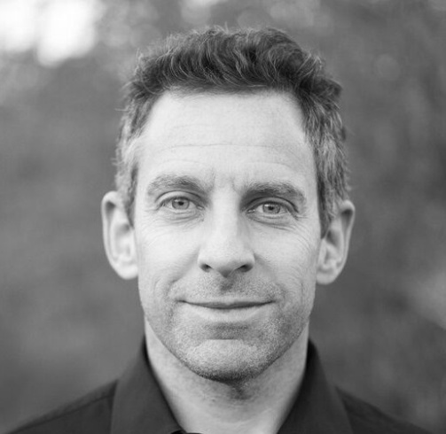
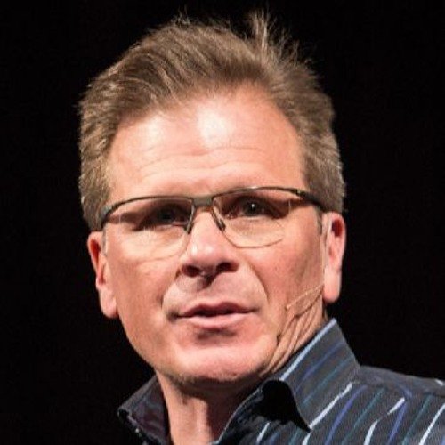
Determinism is self-defeating
"Free will is an illusion. Our wills are simply not of our own making. Thoughts and intentions emerge from background causes of which we are unaware and over which we exert no conscious control." - Sam Harris (philosopher and neuroscientist).
If determinism is true, then anyone who thinks that determinism is true did not come to that belief rationally. Their belief was dictated through the physical constraints of their brain chemistry, genes, upbringing, and environment.
If our thoughts are not rational, then why should we believe them? What is there about firing neurons simply following the laws of physics that inspires us to trust them? How do we decide which thoughts are illogical and which are rational?
"For a materialist, the laws of physics determine everything we think and do. If that's the case - if we are mere meat machines without free will - then we have no justification to believe anything we think, including any thought that atheism is true. As meat machines completely determined by the laws of physics, we cannot reason; we can only react." - Frank Turek

Slide 9
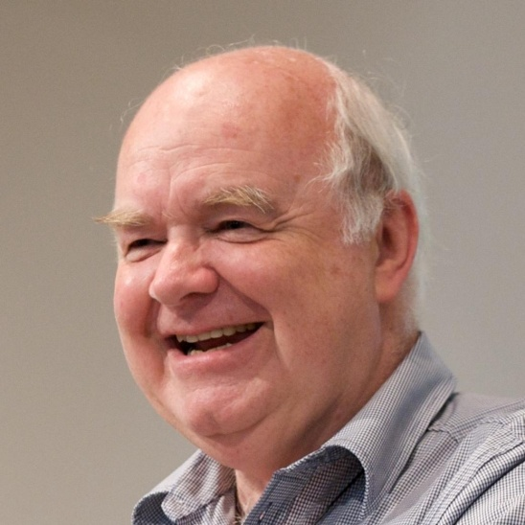
Determinism is self-defeating
“Naturalism is fatally flawed. It undermines the foundations of the very rationality that is needed to construct or understand or believe in any kind of argument whatsoever, including those that are used to defend naturalism. It therefore doesn’t simply shoot itself in the foot, which is painful; it shoots itself in the brain, which is fatal.” – John Lennox
Between free will and determinism, a free will position is the only position that is intellectually defensible because it stands on a foundation of reality.
Determinism seeks to deny the reality of our conscious minds and our persistent, practical experience of making free choices everyday.

Slide 10
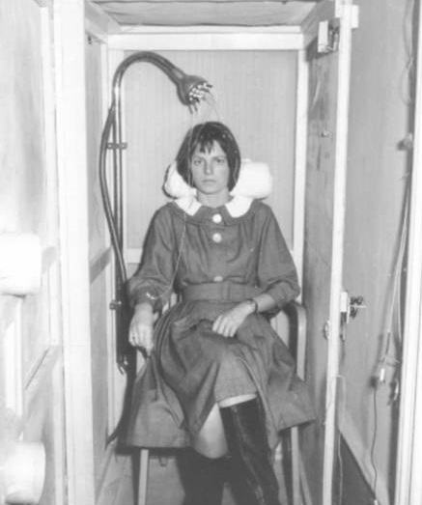
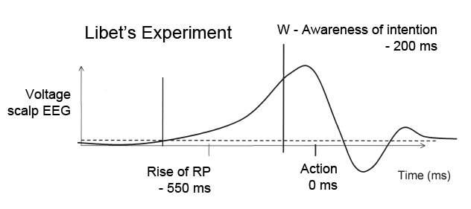
Does science support free will or determinism?
In the 1980s, neuroscientist Benjamin Libet ran some experiments in which people were hooked up to an EEG machine to read their brain activity while they made choices to move their wrists.
Libet found that his subjects showed brain activity preceded their decisions to move their wrists, confirming the results of a previous experiment in 1964. This preceding brain activity was called the “readiness potential”.
Determinists often argue that this “readiness potential” shows that our choices are actually just brain activity leading up to an action before we are even aware of our “choice”.

Slide 11
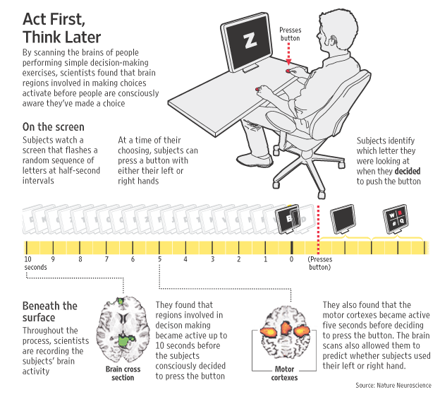
Does science support free will or determinism?
In 2007, Professor John-Dylan Haynes from the Berlin School of Mind and Brain ran similar experiments. His subjects were given a button for each hand and told to press them the moment they made a decision while their brain activity was monitored with an MRI.
The results showed that unconscious brain activity not only preceded their decisions by 7 to 10 seconds, but also predicted which hand would be used to press a button.
This is used to further support the idea that our decisions are simply the end result of our brain activity.

Slide 12
Does science support free will or determinism?
However, these experiments can be interpreted in different ways.
It now appears that the brain activity preceding a decision is occurring during the initial planning portion of the subject’s thought process prior to making a choice, rather than the choice itself. The 7 to 10 second period of brain activity is far more consistent with conscious or unconscious planning than conscious choosing.
It is interesting to note that Benjamin Libet himself believed in free will and did not think that his experiments disproved it.
Libet found that his test subjects could experience an urge or wish to move their wrists but then decide not to, and there was no “readiness potential” that preceded the veto of that decision. He also said that subjects could veto an act planned for a certain time, reporting, “A large RP preceded the veto, signifying that the subject was indeed preparing to act, even though the action was aborted by the subject”.
Libet writes, “The role of conscious free will would be... not to initiate a voluntary act, but rather to control whether the act takes place. We may view the unconscious initiatives for voluntary actions as ‘bubbling up’ in the brain. The conscious-will then selects which of these initiatives may go forward to an action or which ones to veto and abort, with no act appearing.”

Slide 13
Does science support free will or determinism?
“Libet’s finding that there appear to be pre-conscious intentions that sometimes
precede conscious intentions is unsurprising. We experience such intentions
constantly. We walk from place to place without consciously thinking of the intricate
details of the walk — the path, the coordination of muscles, etc. We often get where
we’re going with remarkably little conscious attention to the process... When we
type... we typically don’t think about the individual motion of our fingers... That
doesn’t mean that our typing or walking or driving is not freely chosen. It means that
much of our deliberate behavior is the result of a combination of a free choice to act
and an elaborate preconscious and unconscious system of intentions that enable the
freely chosen act to happen efficiently.” – Michael Egnor, neurosurgeon.
Scientists are still working on this topic. In 2010, a researcher called Aaron Schurger noticed something that looked like the “readiness potential” in normal brain activity. Normal neural activity is “the churning hum in the brain that emerges from the spontaneous flickering of hundreds of thousands of interconnected neurons. This ongoing electrophysiological noise rises and falls in slow tides, like the surface of the ocean” ^{(Source)}. Schurger suggested that the “readiness potential” is not actually a mark of intention, but is more of a symmetry breaking “scale tipper” for arbitrary decisions.
This idea fits well into Libet’s experiments, where people just moved their wrists when they felt like it. In order to prevent someone from endlessly pondering when to move their wrists, the natural rising “tide” of brain activity would tip the scales toward making a decision. Other studies have supported this idea.

Slide 14
What is the best explanation for our free will?
We’ve seen that free will is the only intellectually defensible position (because determinism is self-defeating), and that science has not shown determinism to be true. In fact, science has given support to the idea of free will by showing that people can veto their urges to act.
Free will has no place in a purely naturalistic, determined universe. All physical things in our universe react according to the laws of physics. Free will is utterly different and unexpected and all attempts to explain it from within the universe have failed.
The most reasonable explanation, therefore, is that our free will came from a source outside of the universe – a Source that is capable of creating humans with consciousness and the freedom to make personal decisions.

Slide 15
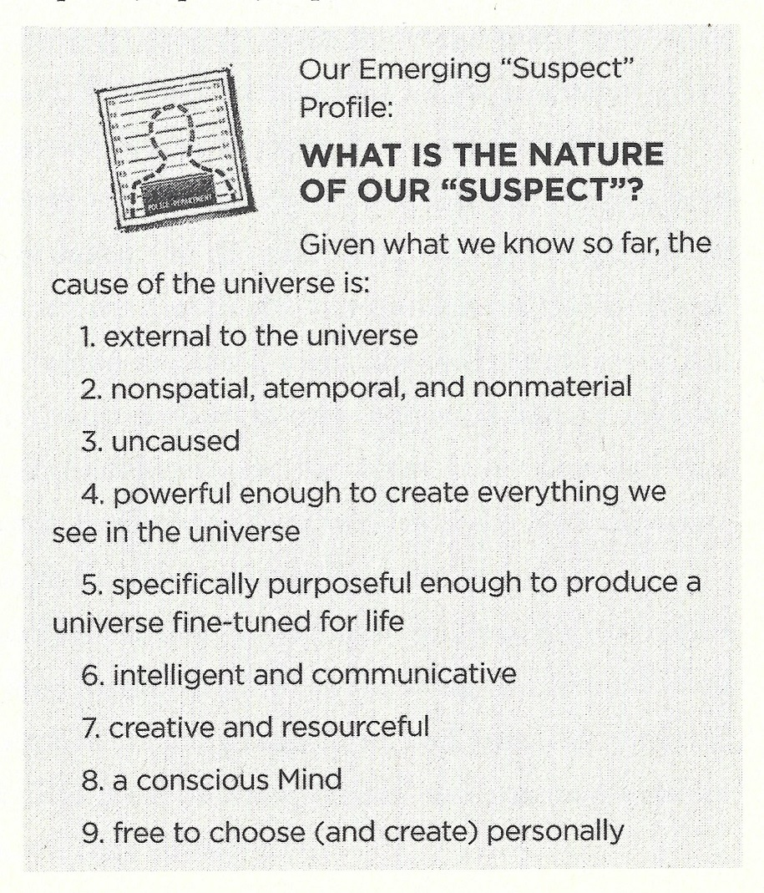
Our Suspect Profile
Origin of the universe
Fine-tuning of the universe
Information in DNA
Design in biology
Existence of consciousness
Existence of free will

Slide 16
Objections
Free will is an illusion.
This does not account for our common experience of free will.
This would mean that jails and penitentiaries are only for detainment rather than correction.
If my free thoughts tell me that free will is an illusion, then why would I believe my own thoughts?
Free will emerges from a deterministic system as a spontaneous property of the system.
There is simply no evidence to support this idea. Proponents of this idea need to provide reasons for believing it.
This idea acknowledges the existence of nonmaterial properties without actually explaining them.
Free will is caused by indeterminacy at a quantum level. Quantum particles are not always predictable and some may not even be causally connected. This could mean that part of the universe is actually indeterministic, which could explain our experience of free will.
Many scientists and philosophers think that there are still unknown variables operating at the quantum level that may lead to quantum particles being causally predictable as larger scale objects. The indeterministic nature of quantum physics is not a consensus opinion.
Even if quantum physics were in part indeterministic, why would that transpose to the macro level and affect our brains and thoughts?
If this were true, that means that our thoughts are indetermined, which still gives us no reason to trust them.

Slide 17
Objections
A calculator is determined and operates according to the laws of nature, yet it produces true results. If our thoughts are also determined, then there is no reason not to trust them.
A calculator has been specifically designed to perform mathematical operations on a series of inputs to produce a correct output. There is no reason on a naturalistic worldview to compare that to our brains, which are the end results of the unguided, mindless process of evolution.
Having free will means that we could have chosen differently. But we can’t know if we could have made different choices because we can’t go back in time to see.
Remember we defined free will as “being able to freely act or think without being determined by causal factors outside your own mind.” This does not necessarily mean that we could or would have chosen differently. It just means that we did not act according to physical causal factors.
If someone put a bowl of fertilizer and a bowl of soup in front of me, I’ll choose the soup. Even if I went back in time to face the same choice, I’ll most likely keep choosing the soup. Not because I’m determined to, but because I freely choose to eat soup rather than fertilizer.
Our definition may well describe the way in which God Himself has free will. God is a maximally great Being, which means He is morally perfect. As such, He will only do what is good. But this is not a limitation imposed on Him from outside Himself, but rather a limitation that comes from His perfect nature. Since He is not determined by causal factors outside Himself, we can truly say that God is free.

Slide 18
Objections
Even on theism, we don’t have free will. If God is omniscient and knows the future, then that is the future that will happen. We cannot make choices that lead to a different future than the one that God knows will happen. So we don’t have free will.
C. S. Lewis pointed out that God’s knowledge that something will happen does not take away people’s freedom. Let’s say you watched someone make a decision and then travelled back in time to watch them do it again. Your knowledge of what they were going to do does not remove their free will from their action. In other words, knowledge is not causal.
Our natural impulses, preferences, and desires which play a strong role in how we make decisions come from our genes and upbringings. We do not have the freedom to choose our genes and upbringings, so how can we say that we have free will?
This is not what we mean by “free will”. This is what philosopher Alvin Plantinga calls “maximal autonomy”.
While our desires and impulses will often factor in to our decision-making process, our free will means we have the ability to choose beyond their influence (as shown by Libet’s experiments).

