Slide 1
Consciousness

Slide 2
What is consciousness?
Simply put: being self-aware.
Imagine you are having surgery on your knee. As you start to wake up, you hear the sounds of equipment and the voices of hospital staff around you. You feel the fabric of the bed sheets, a dull pain in your leg, and some hunger and thirst. You are becoming aware of yourself and your surroundings. You are gaining consciousness.
The question is: where does consciousness (or minds) come from?

Slide 3
“But minds are just brains!”
Many people will say that the brain is the same thing as the mind, positing an identity relationship.
There are around 4 fundamental laws of logic. In this situation, we can use the Law of Identity:
A = A
This law of identity means that two things are identical if they have the same properties:
Properties of A = Properties of A
If Brain = Mind, then all the properties of a brain must equal the properties of a mind. So the grand question is:
Do brain properties = mind properties?

Slide 4
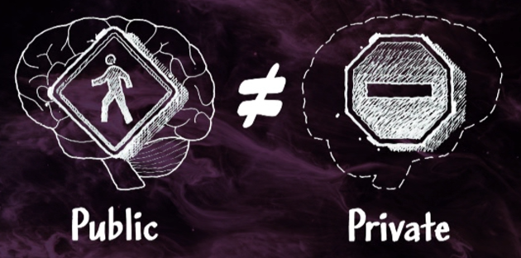
5 ways in which brains and minds differ:
If you closed your eyes and imagined a unique car, only you would know what that car looks like. Its shape, colour, and textures would exist only in your conscious thoughts.
Neuroscientists could not open your head up and see the car there. They could publically access your brain, but they could not access your private thoughts.
Even if they saw brain activity firing, they could not map it to particular thoughts unless you told them what you were thinking.

Slide 5
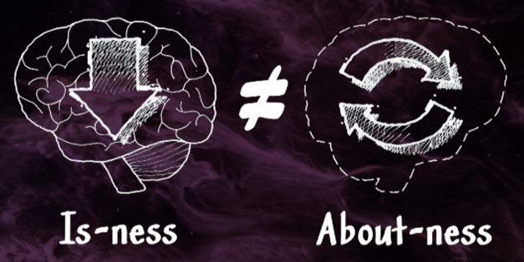
5 ways in which brains and minds differ:
Mental states are directed - they are about something other than themselves.
If I hear a burglar outside my house at night, my thoughts are about that burglar and whether or not my door is locked. My mental state is dependent on the physical state of the burglar and the door. It has an “about-ness” about it.
Physical things like the door are not about anything. They simply are. They are undirected. They have an “is-ness” to them.

Slide 6
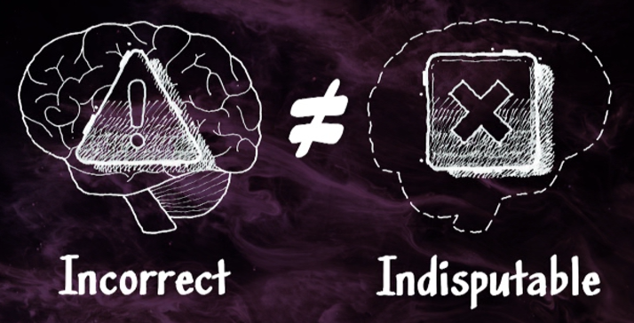
5 ways in which brains and minds differ:
Sometimes our thoughts are incorrect. I may think that a burglar is outside my house, but I could be wrong. There may not be a burglar at all.
However, my thoughts about the burglar are indisputable.
You can be incorrect about physical entities, but your beliefs are indisputable.

Slide 7
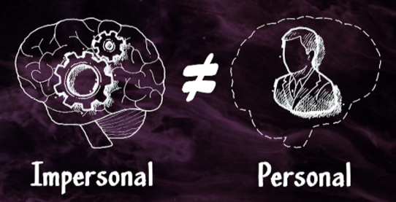
5 ways in which brains and minds differ:
A police officer training for firing a gun in a life-threatening situation will learn as much as they can about the situation. They will learn the physics of the gun, the characteristics of the ammunition, the biology of the human body, the impact a bullet will have on an attacker. For the sake of illustration, let’s say the officer is entirely knowledgeable of every physical aspect of the event.
But the officer will still be missing the experience of being in the shoot out. There will be an experience of thoughts, pains, trauma, desires, etc, that can only be described subjectively.

Slide 8
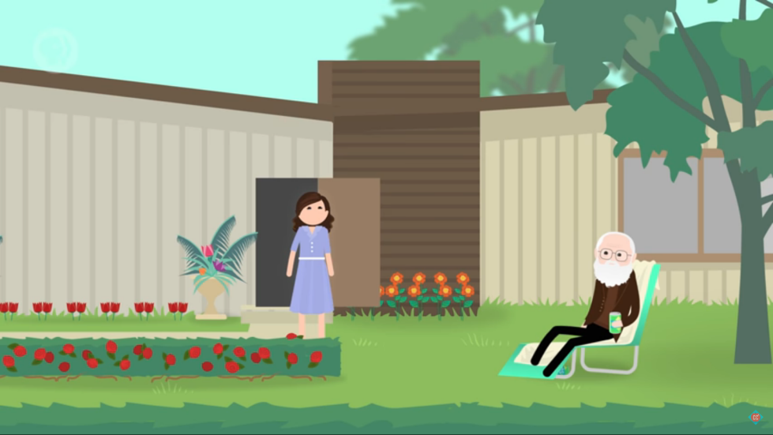
Another example:
Imagine a woman called Mary who has spent her entire life in a black and white room with a black and white TV and books.
Mary spends her time studying neurophysics, specialising in the science of colour. She learns everything there is to know about light, optics, the physics of colour and how it affects our sensory organs and abilities.
But when Mary finally leaves her black and white room and experiences colour for the first time, has she learned something new?
Her knowledge about colours is not the same as her experience of seeing colours.
If everything could be explained in physical terms, then when Mary saw colours it should not have added to her knowledge at all.
Image source

Slide 9
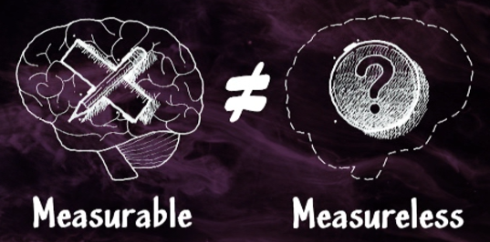
5 ways in which brains and minds differ:
As physical entities, brains can be weighed, measured for length or width, and calculated for mass. Our brains and nervous systems can be described thoroughly using physics and chemistry.
Mental entities (desires, sensations, emotions, wills, etc) cannot be measured or analysed using physics or chemistry. Thoughts may have propositional content, but they do not have physical weight.

Slide 10
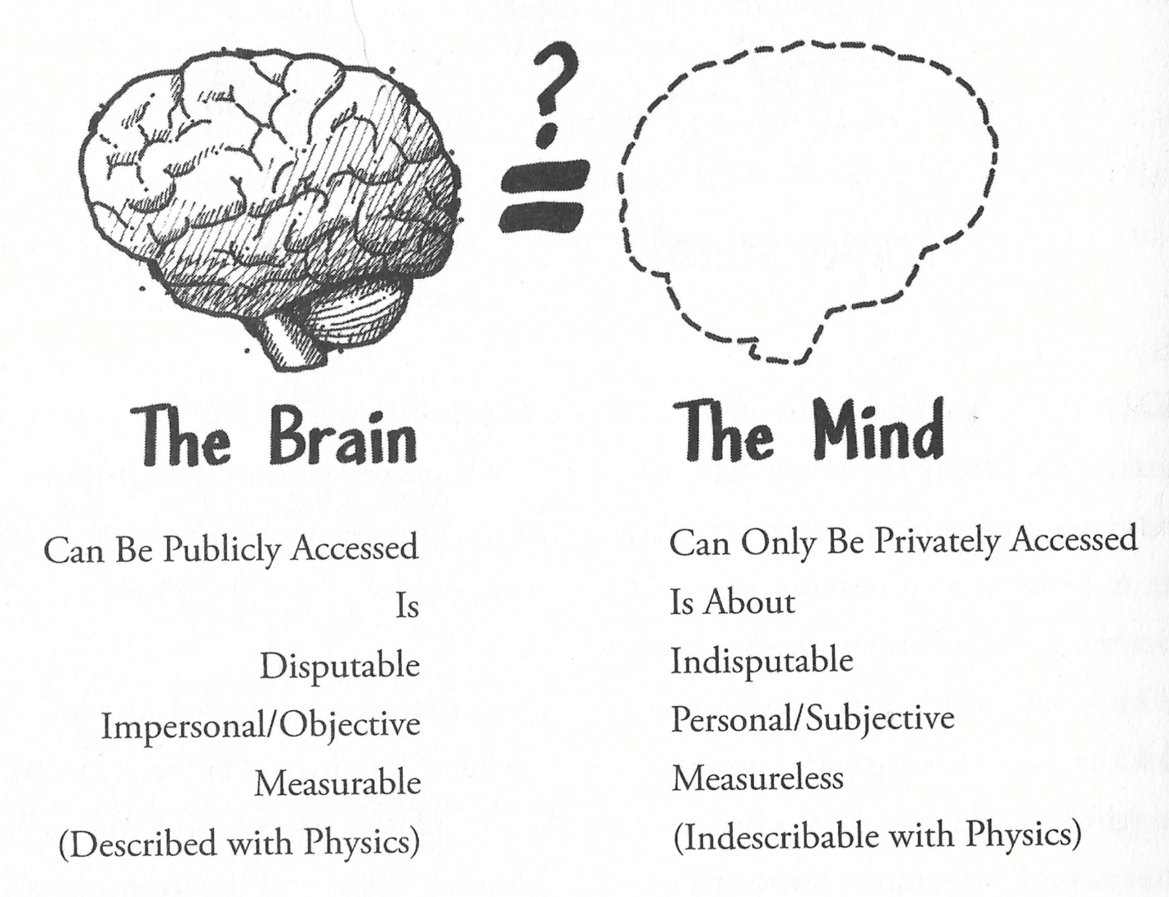

Slide 11
Explanations offered from inside the universe:
1. Mental states are just brain states. Emotional states like anger are just neurological activities in the brain.
- This ignores the 5 ways in which minds differ from brains. Anyone trying to assert that mental states are brain states has to deal with those 5 lines of evidence.
2. Mental states are just behaviours. When we say someone is angry, we are just referring to the behaviours they are showing.
- This tries to redefine our thoughts as physical behaviours.
- We recognise that our thoughts are the cause of our behaviour, not the behaviour itself.
- Not all thoughts or emotions result in a behaviour at all (e.g. controlling our tempers).
3. Mental states are nonexistent. They are just an antiquated description of the physical activity in the brain.
- This again ignores the evidence of how minds differ from brains.
- Skeptics holding this view think they believe something true about mental states: their non-existence. Mental states have an “about-ness” to them which physical things do not have.

Slide 12
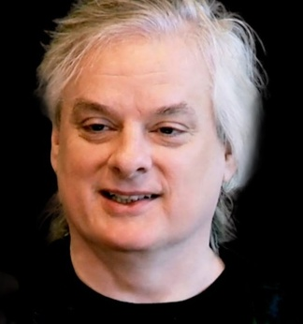
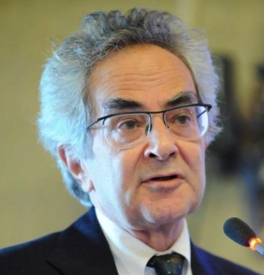
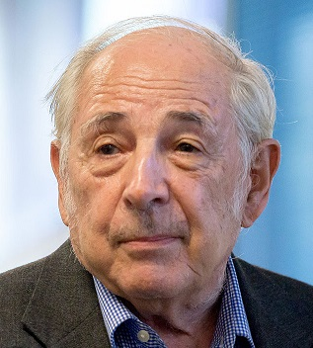
Atheists recognise this “Problem of Mind”:
"Conscious experience is at once the most familiar thing in the world and the most mysterious. There is nothing we know about more directly than consciousness, but it is far from clear how to reconcile it with everything else we know. Why does it exist? What does it do? How could it possibly arise from lumpy gray matter?“
- David Chalmers, philosopher.
“The existence of consciousness seems to imply that the physical description of the universe, in spite of its richness and explanatory power, is only part of the truth, and that the natural order is far less austere than it would be if physics and chemistry accounted for everything. If we take this problem seriously, and follow out its implications, it threatens to unravel the entire naturalistic world picture.”
- Thomas Nagel, philosopher.
“Earlier materialists argued that there aren’t any such things as separate mental phenomena, because mental phenomena are identical with brain states. More recent materialists argue that there aren’t any such things as separate mental phenomena because they are not identical with brain states. I find the pattern very revealing, and what it reveals is an urge to get rid of mental phenomena at any cost.”
- John Searle, philosopher.

Slide 13
Explanation from outside the universe:
Philosopher J.P. Moreland said, “You can’t get something from nothing… If there were no God, then the history of the entire universe… would be a history of dead matter with no consciousness. You would not have any thoughts, beliefs, feelings, sensations, free actions, choices, or purposes. There would be simply one physical event after another physical event, behaving according to the laws of physics and chemistry. How, then, do you get something totally different – conscious, living, thinking, feeling, believing creatures – from materials that don’t have that? That’s getting something out of nothing.
“If you apply a physical process to physical matter, you’re going to get a different arrangement of physical materials… If the history of the universe is just a story of physical processes being applied to physical materials, you’d end up with increasingly complicated arrangements of physical materials, but you’re not going to get something that’s completely nonphysical.
“However… if you begin with an infinite mind, then you can explain how finite minds could come into existence.”
Even in our experience of the physical world, minds come from other minds.
The most reasonable inference of how minds ended up in the physical universe is that they were created by another Mind external from the universe.

Slide 14
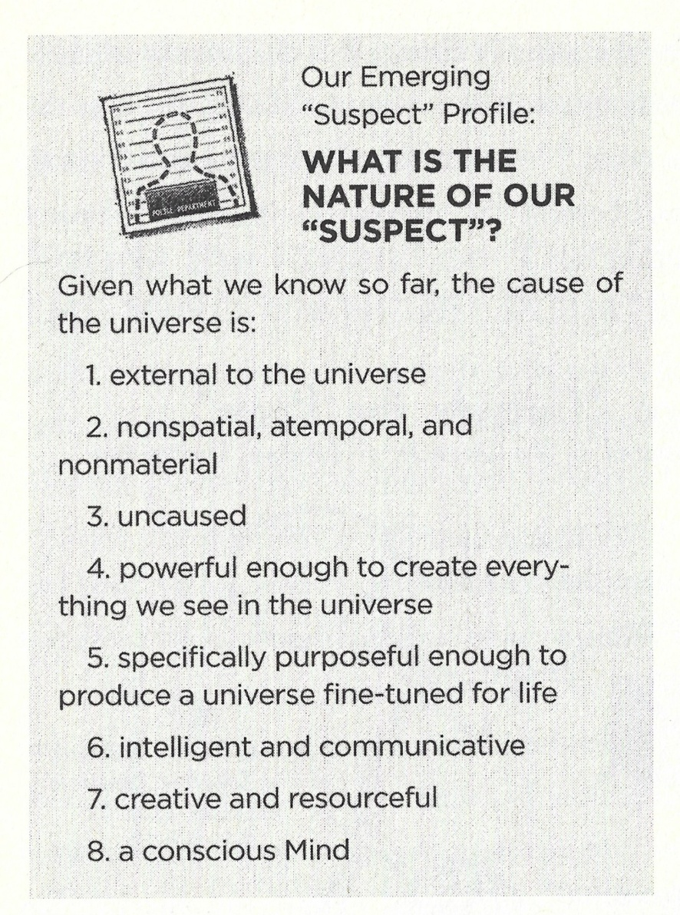
Our Suspect Profile
Origin of the universe
Fine-tuning of the universe
Information in DNA
Design in biology
Existence of consciousness

Slide 15
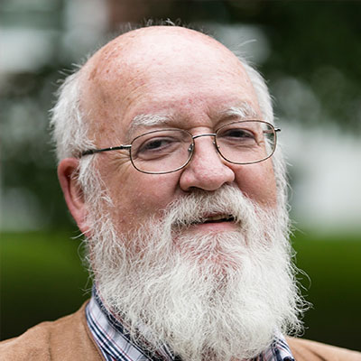
Objections:
Consciousness has a social advantage which leads to a survival advantage. Primitive creatures with a low form of consciousness would have banded together, forming a society which allowed them to survive and reproduce. Over many generations, consciousness grew and developed to the various levels we see today.
This objection starts with consciousness in order to explain consciousness, which actually sounds more like our argument rather than an objection. It does not even attempt to explain how a mind could arise from simple matter.
Philosopher Daniel Dennett has suggested that consciousness is an illusion.
One must have a consciousness first before being fooled by an illusion.
If my consciousness is an illusion, why should I trust any of my conscious thoughts, including the thought that my consciousness is an illusion?

Slide 16
Objections:
Consciousness is a natural by-product of our brain’s complexity.
It emerges as the right matter is arranged in the right way.
Philosopher J.P. Moreland has explained some
problems with this idea:
This is no longer treating matter as naturalists normally do - as brute stuff that can be completely described by the laws of nature. They are now attributing mental potentials to matter that get activated at the right level of complexity. This is called panpsychism, and it’s closer to theism than atheism. If a small mind can emerge when matter reaches a certain level of complexity, why could a far greater mind (God) not emerge when millions of brain states reach a greater level of consciousness?
This idea is deterministic. If consciousness is just a function of the brain, and my brain functions according to the laws of nature just like any other physical thing, why should I trust anything my mind thinks as being rational or true? That would mean that my thoughts are simply reactions rather than being capable of reason.
There would be no “unified self”. Brain function is spread throughout the brain. If you lose 53% of your brain, then you will lose some of that function. But you will not be 47% of a person. We all know that we are unified selves regardless of our brains.

Slide 17
Objections:
If the mind is separate from the brain, why does brain damage affect our mental abilites, like memory loss?
It is clear that the mind and brain are linked somehow, but that does not mean that they are the same thing.
Memories do not have spatial extension, but brains are spatially extended things. Our memories do not reside in our brains.
If you were strapped into a car and unable to get out, your ability to move around town would depend on the car working. But if the steering system broke and could only turn right, you would be limited in which direction you could steer the car.
Or consider a CD that contains musical information. If you put the CD into the right retrieval system, you can play the music. If the retrieval system is damaged, it will distort the music or not play it at all.
A problem with someone’s body may hinder their ability to do something (like memory recall issues after a brain injury or from Alzheimer's), but that does not mean that their mind is the same thing as their brain.

Slide 18
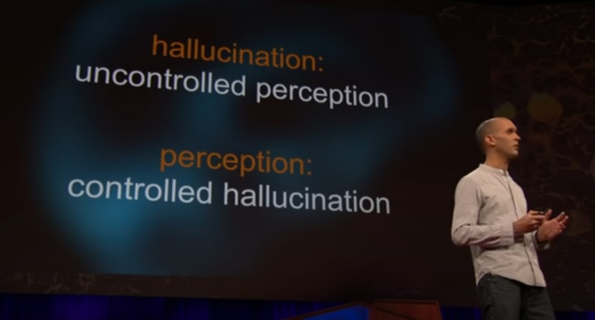
To show how absurd naturalistic attempts to explain mind can get:
This is from an actual TED talk about consciousness.
The speaker was Anil Seth, who is a professor of cognitive
and computational neuroscience at the University of Sussex, and
the co-director of the Sackler Centre for Consciousness Science.
He said:
Hallucination = uncontrolled perception
Perception = controlled hallucination
Anil said, “We’re all hallucinating all the time, including right now. It’s just that when we agree about our hallucinations, we call that ‘reality’.”
If we plug Anil’s definition of a hallucination into his definition of perception, we get:
Perception = controlled uncontrolled perception. What?!
More alarmingly, Anil talked about how he ceased to exist when he went under general anaesthesia for surgery. He said, “Anaesthesia: it’s a modern kind of magic. It turns people into objects, and then (we hope) back again into people.”
By defining consciousness as Anil does, he removes personhood from people who are currently unconscious, meaning we can just treat them as objects.
Source

